Slide 1

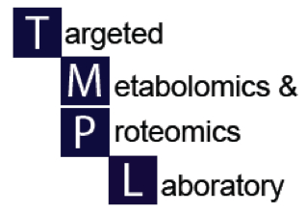

Sample types, storage and extraction for metabolomics
UAB Metabolomics Workshop
December 2, 2015
Stephen Barnes, PhD

Slide 2
Sample selection
This is the most important part of a metabolomics experiment
The samples should be collected according to a written, agreed upon protocol
Sample types
  Biofluids (whole blood, plasma, serum, CSF, sputum, follicular fluid, bile, duodenal fluid, fecal water, lung lavage, aqueous humor)
  Tissues (brain, liver, heart, kidney, adrenals, muscle, ovaries, testes, lung)
  Cells (cancer cells, cardiomyocytes, yeast, oral bacteria)
  Food

Slide 3
Blood
A very important issue is the timing of the collection
  Many components of the circulating metabolome come from the foods that are eaten by the subject
  Unless the question concerns analysis of the postprandial metabolome, it is best if the sample taken is after an overnight fast (animals and subjects)
As for tissues, metabolites can change after collection
Whole blood should be immediately placed on ice and then frozen in liquid N₂, or stored in a -80ºC freezer

Slide 4
Plasma and serum
Plasma requires either EDTA (for LC-MS) or heparin (for NMR) to prevent coagulation
  Treated blood is centrifuged to sediment the red cells and monocytes
  Plasma is aspirated and quickly frozen at -80ºC
Serum requires time for full coagulation
  This involves a period at room temperature
    Keep constant, but be wary of subjects with slow clotting times
  Clotted blood is centrifuged at 4ºC to separate serum
  Collected sera are stored at -80ºC in 0.5 ml aliquots

Slide 5
Other biofluids
Urine
  Best if a 24 h or longer total urine collection is done
    Rodents – collect directly into a beaker embedded in dry ice
    Patients - store at 4ºC during the collection period
    Additives (ascorbic acid, CHCl₃)
  Alternative, a spot urine but collect data on what food had been eaten/any drugs taken prior to collection
  Centrifuge to remove precipitates
  Store at -80ºC
  Best if stored in 100 μl aliquots

Slide 6
Tissues
The metabolome will change very quickly as soon as the sample is taken
Where possible, place immediately into liquid N₂ before proceeding
  Store at -80ºC
Blood metabolites contaminate tissues
  For animal studies, expose organ and flush its venous blood supply with ice-cold, physiological saline
  Then snap-freeze tissue with flat-faced tongs dipped in liquid N₂

Slide 7
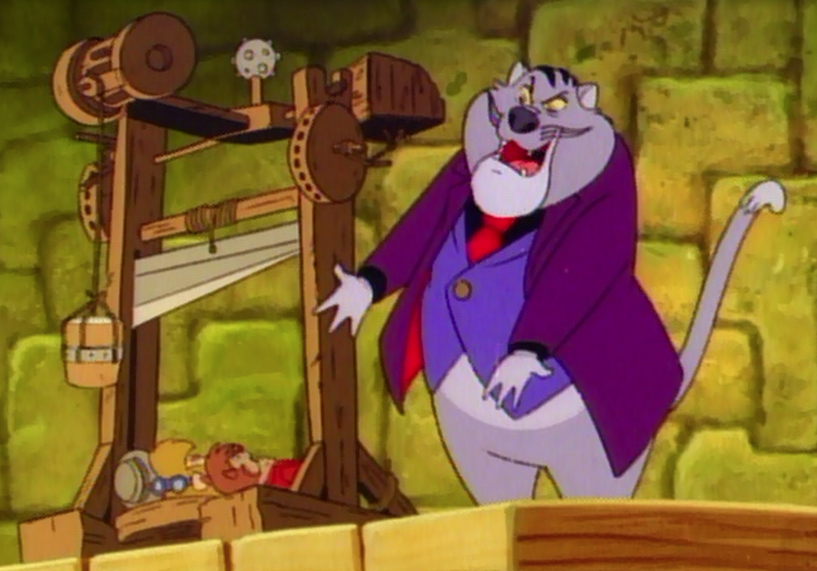
Anesthetics/analgesics
Prior to sampling of blood, other biological fluids and tissues, it may be necessary to use an anesthetic.
  The time to anesthetize an animal will alter the metabolome
  Ideal method is to use a guillotine, fast tissue excision and liquid N₂
If the IACUC-approved protocol requires an analgesic, it (and its metabolites) will be present
  Discuss with IACUC possible alternative methods

Slide 8
Documenting patient therapeutics
Most patients in a study are taking additional drugs or dietary supplements that add compounds to the metabolome
These xenobiotics also undergo metabolism
  Phase I
  Phase II
  Microbiome-based
  Also regulate the microbiome which in turn may alter the metabolism
Watch out for patients taking antibiotics

Slide 9
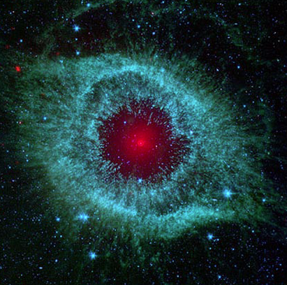
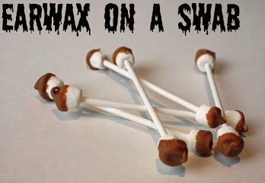
Extracting the metabolome
“From H₂ gas to ear wax”
We’ve been asked to analyze fecal gases!
No single extraction procedure exists that is optimal for all metabolites
The default method is very cold methanol:water (4:1)
If the analytes in the metabolome are known, then more hydrophobic solvents can be used
pH affects the extraction – acid, neutral and basic

Slide 10
Internal standards
Isotopically labeled metabolite standards are essential to monitor recovery during the extraction process
  Same amount added to all samples
  ¹³C is better than ²H, but is more expensive
  Need to increase the mass by 4 Da compared to the unlabeled biological metabolite to avoid natural abundance ¹³C
  A typical set would be ¹³C₄-succinate, ¹³C₁₆-palmitate and L-¹³C₉-tyrosine

Slide 11
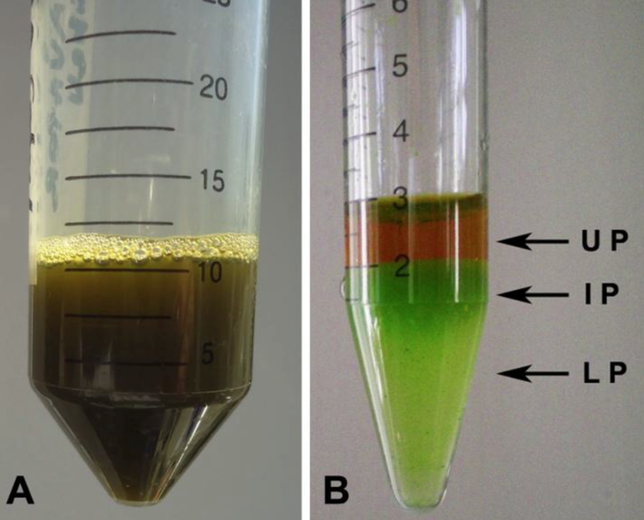
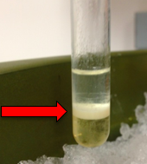
Extracting biofluids
Protein precipitation with acetone or methanol
Plasma partitioned between chloroform-methanol (lower phase) and water (upper phase)
Proteins precipitate at the interface
Lower phase contains lipids
Upper phase has more hydrophilic metabolites

Slide 12
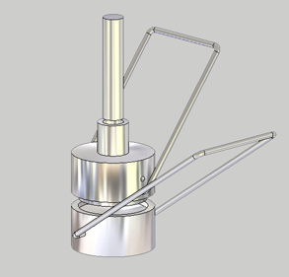
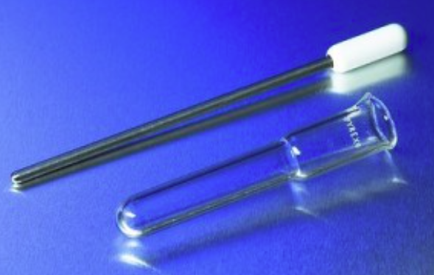
Extracting tissue
Metal percussion mortar cooled in liquid N₂
Grind tissue at <-100ºC
Pour pulverized tissue into cold extraction solvent
Glass tissue homogenizer cooled in liquid N₂
Pestle is PTFE or glass
Can be very small
Ultrasonication after adding solvent
http://www.metabolomicsworkbench.org/protocols/index.php for specific protocols

Slide 13
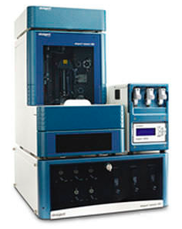
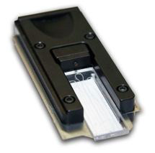
The LC-MS platform
Metabolites are separated on the basis of their hydrophobicity (using a reverse-phase column) or hydrophilicity (HILIC column) using solvent gradients
UPLC
  High resolution chromatography (human samples)
NanoLC
  for precious or low volume samples
nanoLC placed in a temperature-controlled Nanoflex™
Column etched on a chip
All about reproducibility

Slide 14
The mass spectrometer
Ions
  These can be +ve and –ve (require separate LC runs)
  Several thousands can be measured
  Some are adducts of the same metabolite
    [M+H]⁺, [M+Na]⁺, [M-H]⁻, [M-H.COO]-
Untargeted LC-MS
  In this mode need a (very) fast analyzer for MS and MSMS analyses
  Time-of-flight (TOF) is the best
    New instrument from Sciex can collect data at 5 msec intervals
  Orbitrap/FT-MS have better mass accuracy, but not at this speed
    Used in follow up experiments where more time is available

Slide 15
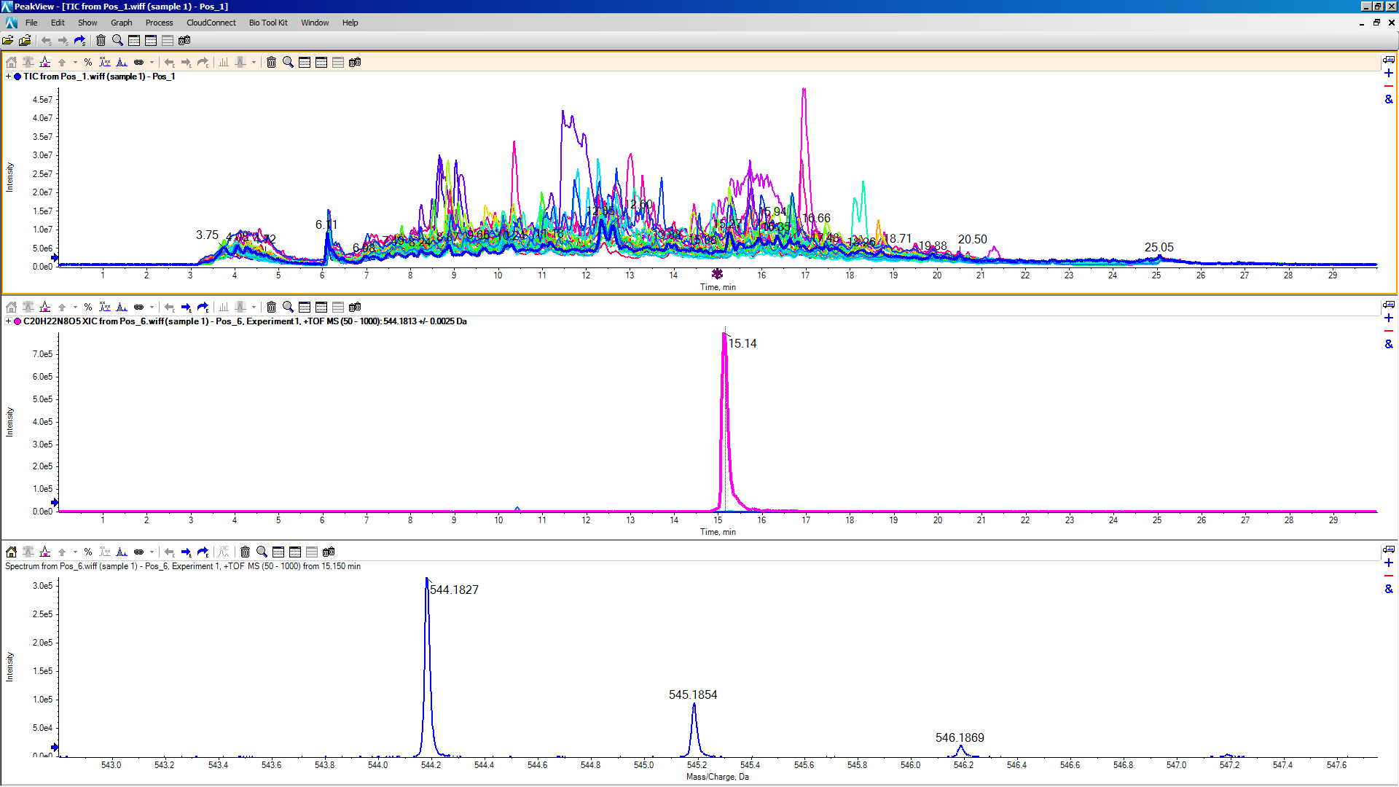
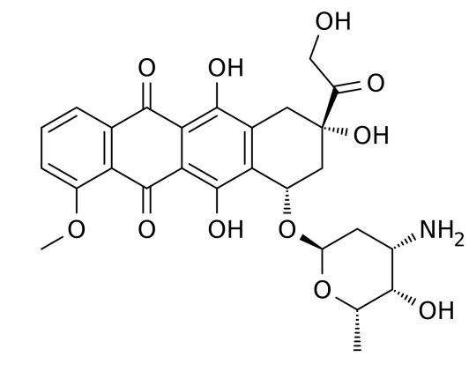
Doxorubicin
Total ion current of all patients
Searching for doxorubicin – found in just one patient
¹³C-isotope peaks

Slide 16
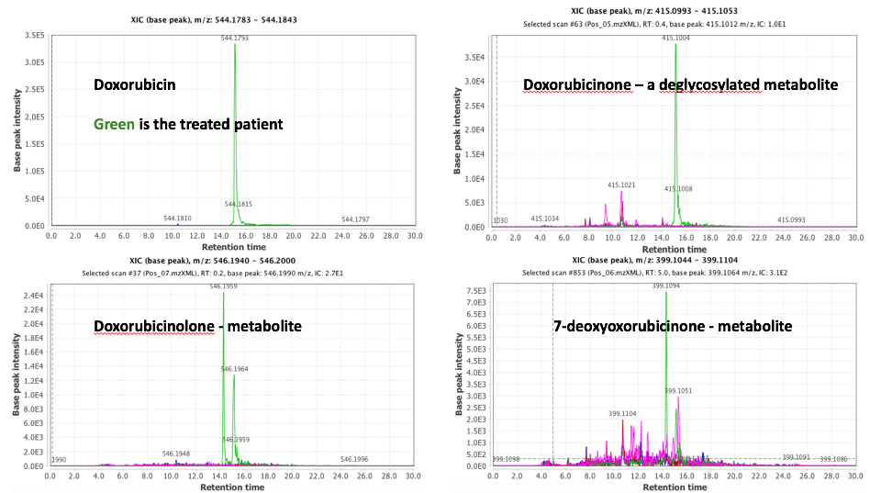
The metabolites of doxorubicin

Slide 17
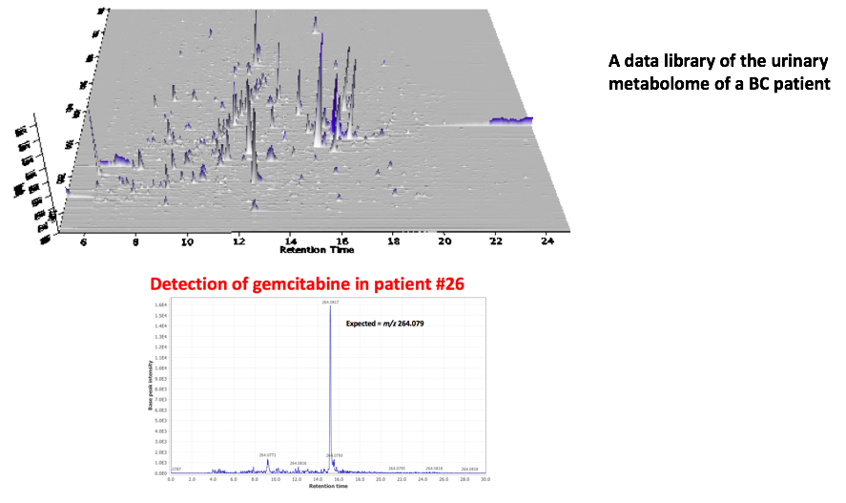
Metabolomics and drugs in patients
Analysis with MZmine
Untargeted metabolomics better defines the patient in a clinical study

Slide 18
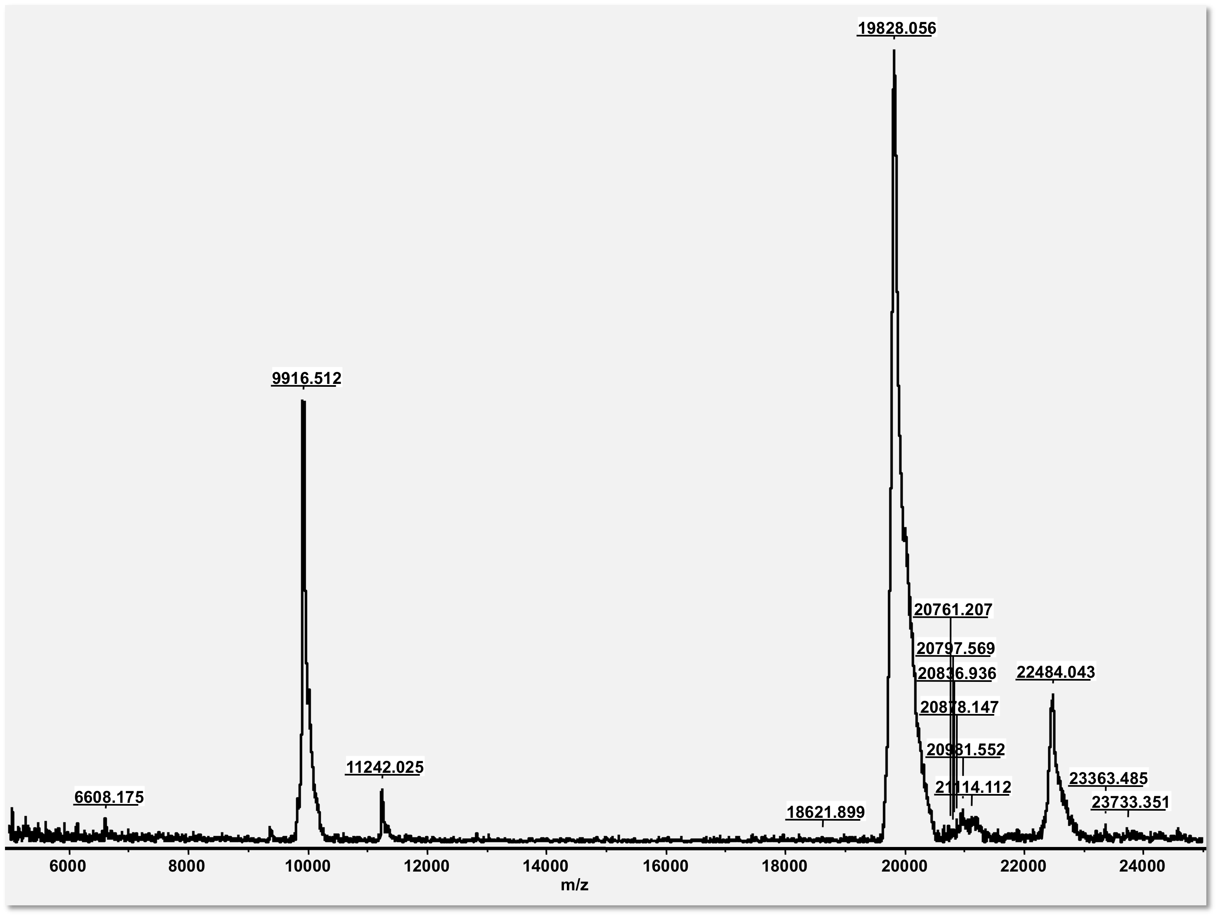
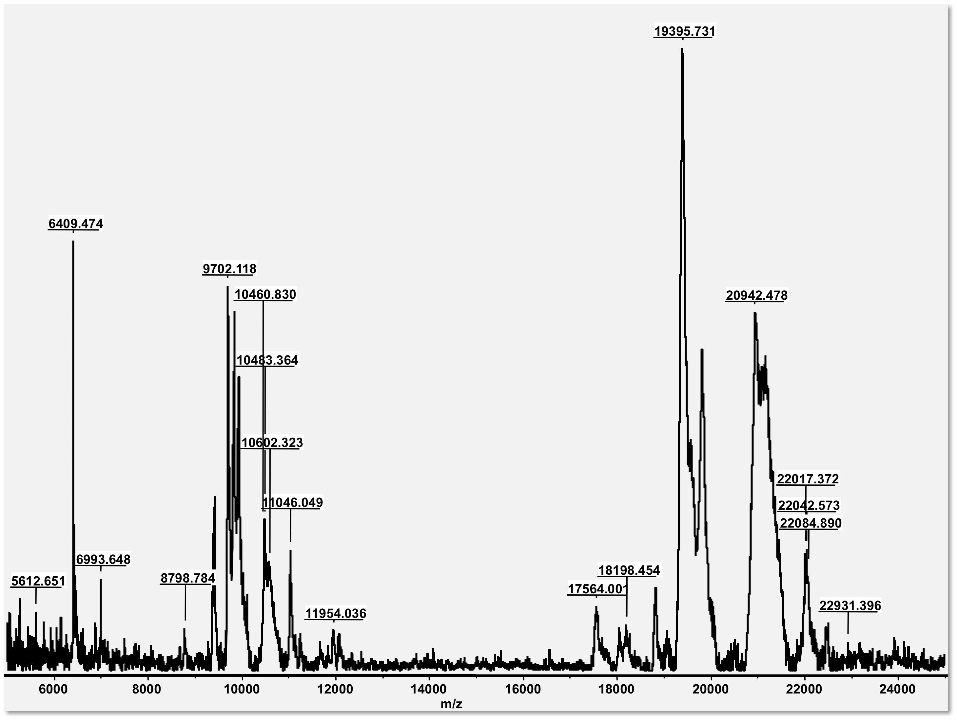
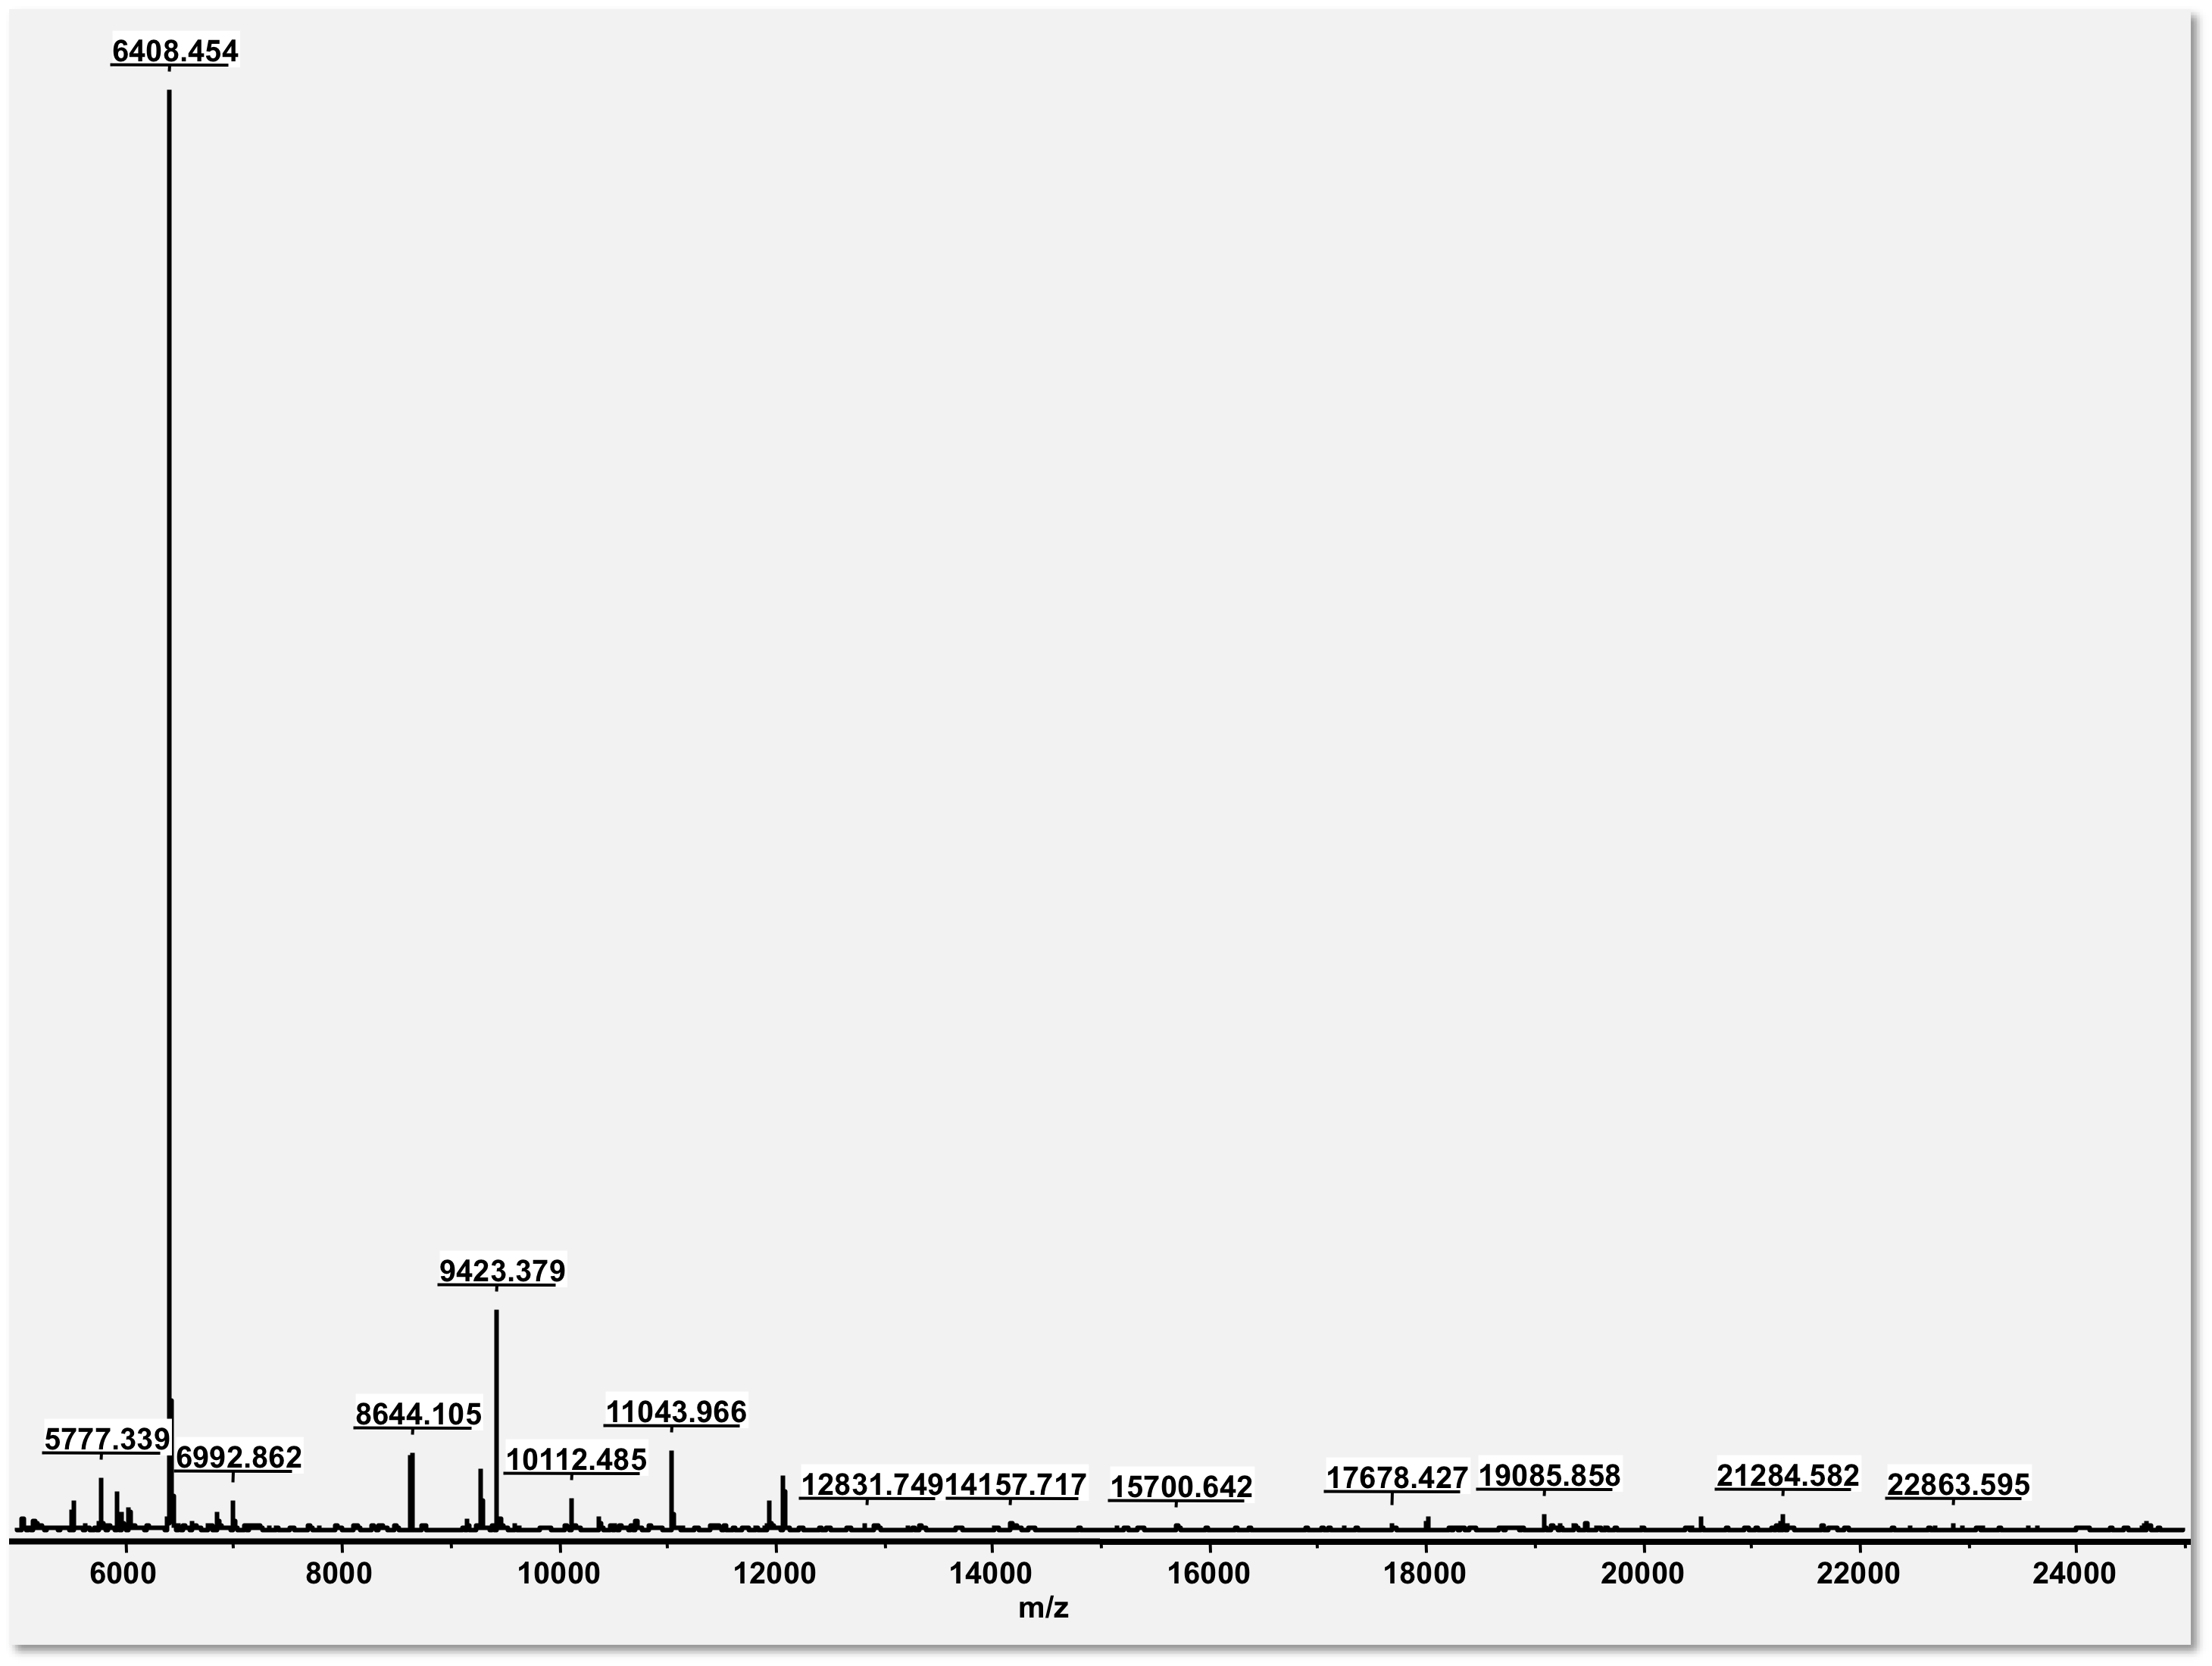
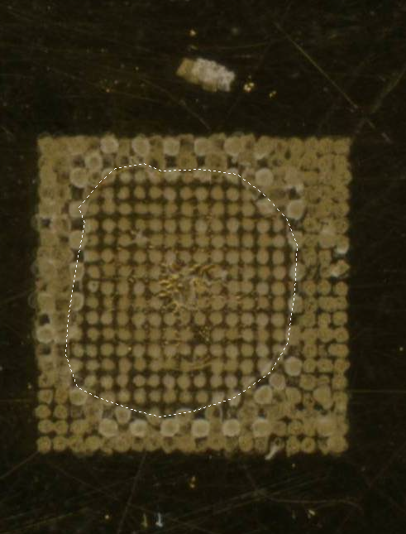
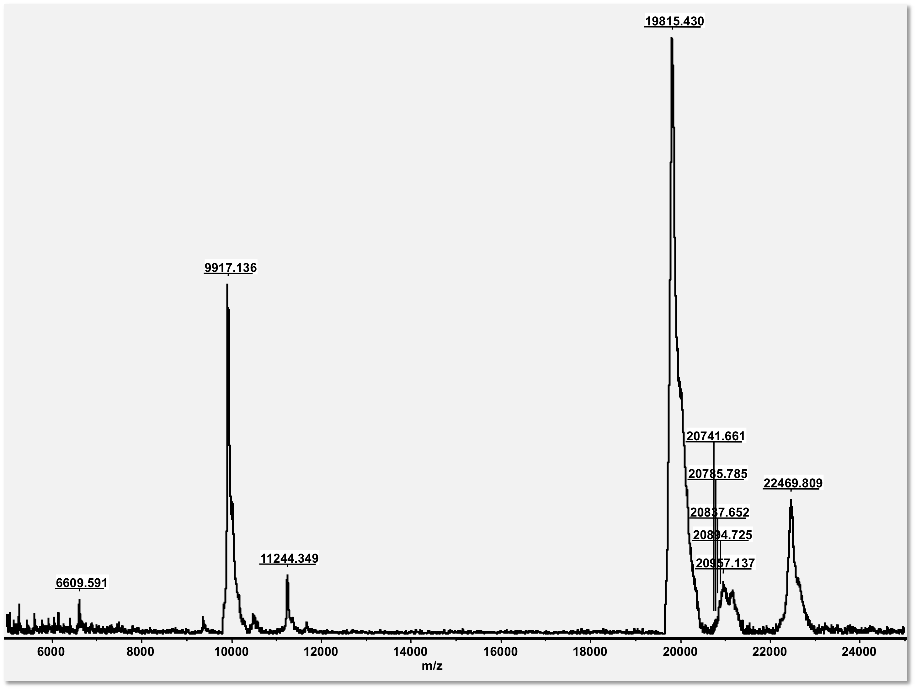
Imaging Mass Spectrometry – rat lens
`

Slide 19
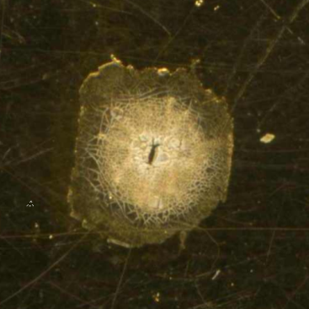



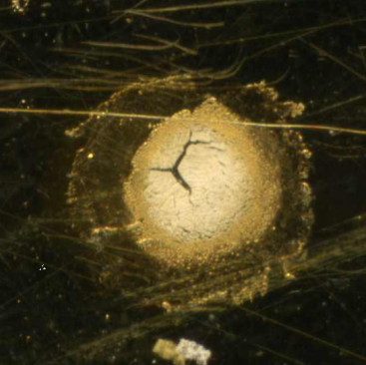



Extracted m/z values: the image
Full-length αA-crystallin
(19,835 Da)
Light microscope image
“αA-crystallin”
(?)
(6,409 Da)
Merged images
21-day ICR/f rat
m/z = 19,822 Da
m/z = 6,409 Da
Merge
100-day ICR/f rat
m/z = 19,822 Da
m/z = 6,409 Da
Merge
Stella et al. IOVS 51: 5151 (2010)

